Slide 1
Manifold Learning and Artificial Intelligence
Lecture 1 Introduction
Paradigm Shift from Euclidean Space to non-Euclidean Space
Meeting ID: 933 1613 9423
Passcode: 416262
https://uwmadison.zoom.us/j/93316139423?pwd=Q0NVWFYvRFg5RmxCNkwxMmYrbW41dz09
momiao. xiong@gmail.com
shihcheng.guo@gmail.com
Github Address: https://ai2healthcare.github.io/

Slide 2
The primary goal of this lecture is to make manifold models accessible to a wide audience in artificial intelligence, computer science, statistics and mathematics by providing an introductory course.

Slide 3
Introduction 1 Embedding
Introduction 2 Genomics, Molecular, Protein and Biomedical Data Analysis in Manifolds
Introduction 3 Manifold Statistics and Optimization

Slide 4
Number of Papers Published in manifold learning area before September 2022
Manifold Learning: 1697
Geometric Learning: 706
Differential Geometry: 431
Laplacian Operator: 85
Computational Topology: 130
Topology and AI: 98
Total: 3147

Slide 5
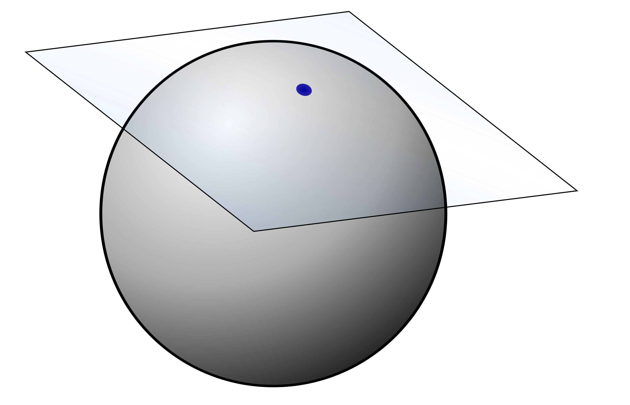




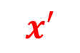

$$F(x)$$
Tangent Bundle:
Collection of tangent spaces at all points
$$T_{x}𝓧$$
$$x$$
$$F(x^{′})$$
$$x′$$
$$T_{x′}𝓧$$
Tangent Space
Inner Product:
${<.,.>}_{T_{x}𝓧}: T_{x}𝓧×T_{x}𝓧→R$ is called Riemannian metric
A manifold equipped with a metric is called a Riemannian manifold.

Slide 6
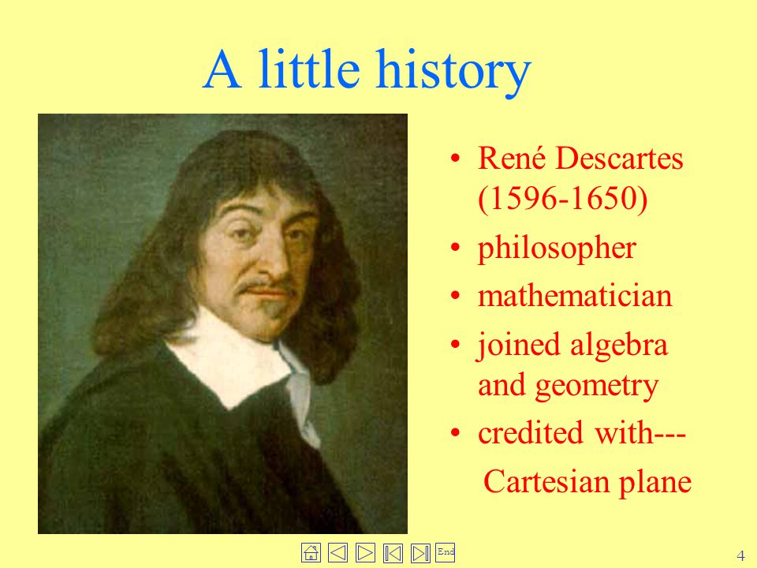
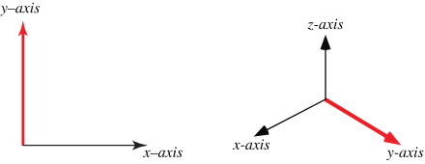
1.1. Coordinate System
Coordinate system is a foundation for every quantitative science, engineering, health and medicine. Classical physics, mathematics and statistics are based on Cartesian coordinate system. Coordinate system is a foundation of science.

Slide 7
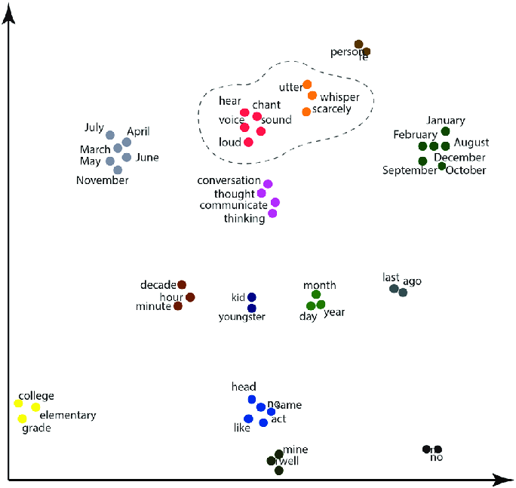
1.1. Coordinate systems for Non-Euclidean Data
1.1. 1. Word Embedding
Word embedding is to map words into the Euclidean space. The words with semantic meaning will be clustered together. It maps non-Euclidean dta to Euclidean space.
Word embedding is implemented by neural networks.
Word embedding is perhaps one of the key breakthroughs for the impressive performance of deep learning methods on challenging natural language processing problems.

Slide 8
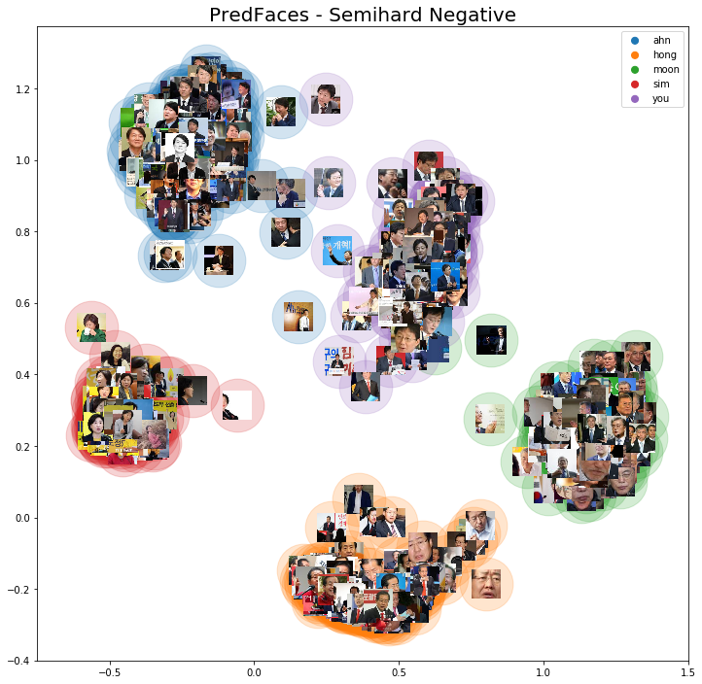
1.1.2. Image Embedding

Slide 9
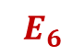



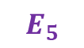
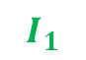




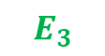
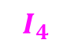
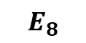
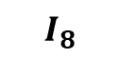
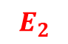
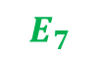
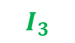
1.1.3.1 DNA Embedding
Final DNA Embedding
Transformer
Input Embedding
$$I_{1}$$
$$I_{2}$$
$$I_{3}$$
$$I_{4}$$
$$I_{5}$$
$$I_{6}$$
$$I_{7}$$
$$I_{8}$$
=
Positional Embedding
$$E_{1}$$
$$E_{2}$$
$$E_{3}$$
$$E_{4}$$
$$E_{5}$$
$$E_{6}$$
$$E_{7}$$
$$E_{8}$$
$$+$$
Token Embedding
$E_{[CLS]}$ ${ E}_{AAG}$ ${ E}_{AGC}$ ${ E}_{GCC}$ $E_{CCT}$ $E_{CTG}$ $E_{TGC}$ $E_{[SEP]}$
[CLS] AAG AGC GCC CCT CTG TGC [SEP]
[CLS] AAG AGC GCC CCT CTG TGC [SEP]
AAGCCTGC
DNABERT: pre-trained Bidirectional Encoder Representations from Transformers model for DNA-language in genome, Bioinformatics, 2021 Feb 4;btab083.

Slide 10
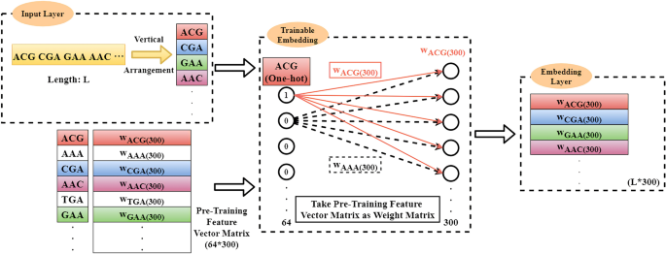
1.1.3.2. DNA embedding
Wu et al. 2021. A deep learning framework combined with word embedding to identify DNA replication origins. Scientific Reports volume 11, Article number: 844 (2021)

Slide 11
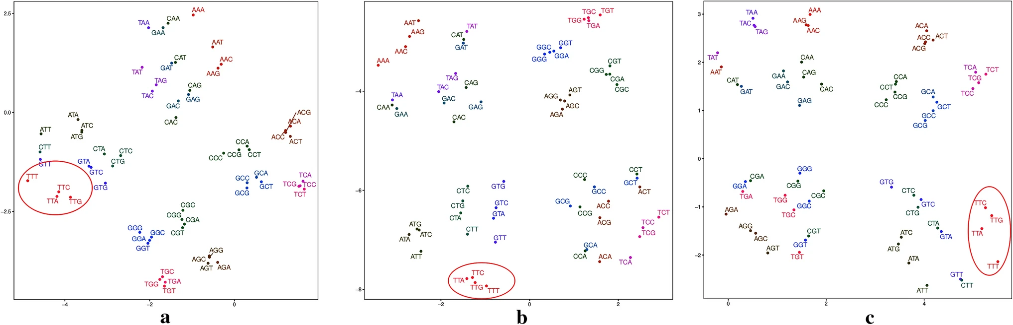
1.1.3.3. Examles of DNA embedding
Wu et al. 2021. A deep learning framework combined with word embedding to identify DNA replication origins. Scientific Reports volume 11, Article number: 844 (2021

Slide 12

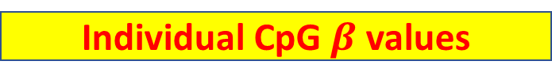
1.1.4. Methylation Embedding
Individual CpG $β$ values
Encoder
Network
VAE
Embedding
Decoder
Network
Approximate $β$values
MethylNet: An Automated and Modular Deep Learning Approach for DNA Methylation Analysis, BMC Bioinformatics volume 21, Article number: 108 (2020)

Slide 13
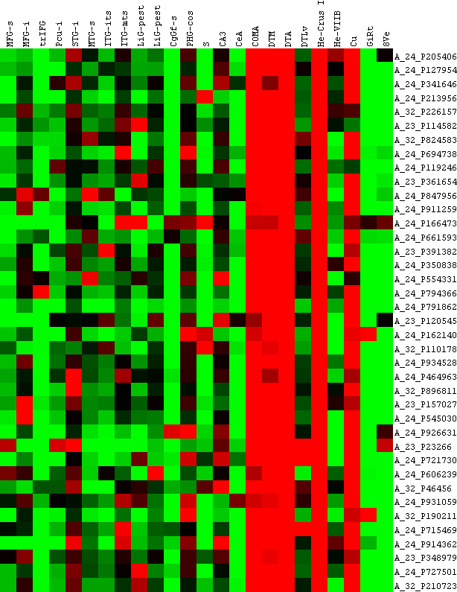
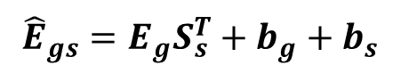
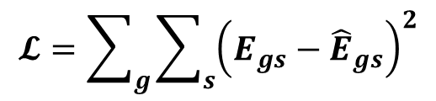
1.1.5. Gene Express Embedding
mRNA Expressions
Neural Networks
Embedding
$${\hat{E}}_{gs}=E_{g}S_{s}^{T}+b_{g}+b_{s}$$
$$𝓛=\sum_{g}{\sum_{s}{{\left(E_{gs}−{\hat{E}}_{gs}\right)}^{2}}}$$
Embedding of Genes Using Cancer Gene Expression Data: Biological Relevance and Potential Application on Biomarker Discovery, Front. Genet., 04 January 2019

Slide 14
1.1.6. Overview of graph embedding methods.
Molecular embedding will be used for chemical property prediction
chemical modeling, and molecule design.
1)vector point-based graph embedding,
2) Gaussian distribution-based graph embedding,
3) dynamic graph embedding.

Slide 15
1.1.6.1. Vector point-based graph embedding methods.
a) matrix factorization-based methods(GraRep , HOPE ),
b) random walk-based methods (e.g., DeepWalk , LINE , node2vec), and
c) deep learning-based methods (SDNE).

Slide 16
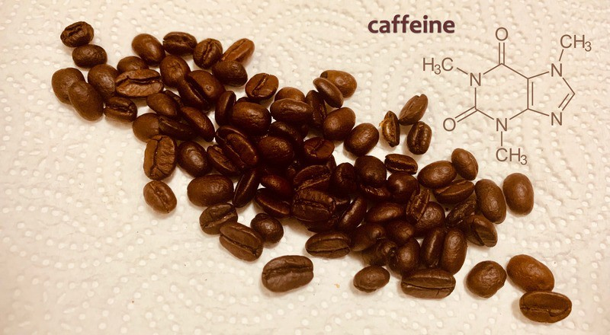
1.1.6.2. Chemical Examples
Basic Molecular Representation for Machine Learning, franky, 2021

Slide 17

1.1.6.3. Illustration of Graph Embedding
Embedding of $V_{N}$
Major Components
Graph structure Preservation
(2) Node similarity
(3) encoder
arXiv:2012.08019
UNDERSTANDING GRAPH EMBEDDING METHODS AND THEIR APPLICATIONS,

Slide 18
1.1.6.4. Vector Point-based Graph Embedding (Random Walk-based Methods)
Node context generation
arXiv:2012.08019
UNDERSTANDING GRAPH EMBEDDING METHODS AND THEIR APPLICATIONS,

Slide 19

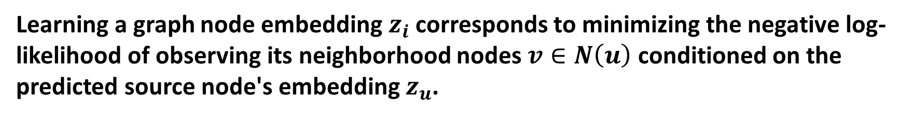

1.1.6.5. Encoder and Loss Function
The encoder is a key and necessary component in graph embedding techniques.
Learning a graph node embedding $z_{i}$ corresponds to minimizing the negative log-likelihood of observing its neighborhood nodes $v∈N\left(u\right)$ conditioned on the predicted source node's embedding $z_{u}$.
The parameters of the embedding model can be learned minimizing the cross-entropy loss:
$$𝓛=−\log{\sum_{u∈V}{\sum_{v∈N(u)}{p(v|z_{u})}}}$$
$$=−\log{\sum_{u∈V}{\sum_{v∈N(u)}{\frac{exp(z_{u}^{T}z_{v})}{\sum_{w∈V}{exp(z_{u}^{T}z_{w})}}}}}$$

Slide 20
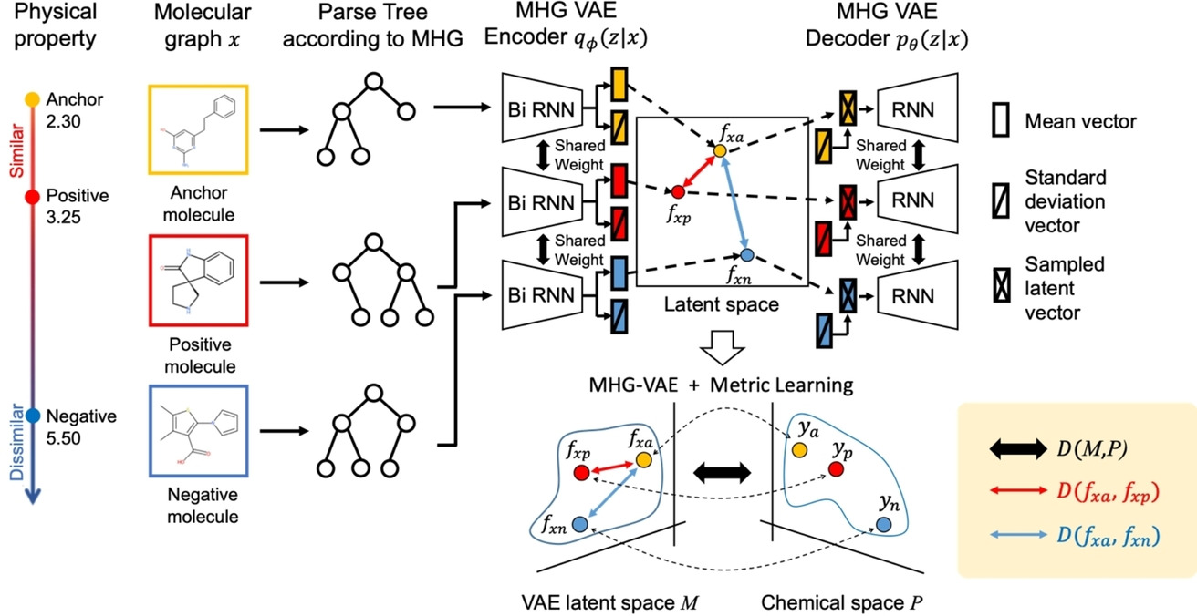
1.1.6.7. Embedding of Molecular Structures
Embedding of Molecular Structure Using Molecular Hypergraph Variational Autoencoder with Metric Learning. Mol. Inf.2021,40,2000203.

Slide 21
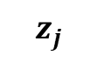
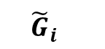
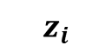
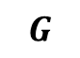
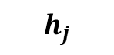
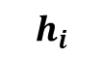

1.1.6.8. Molecular Contrastive Leaarning
Molecular Contrastive Learning of Representations via Graph Neural Networks
Yuyang Wang1,2, Jianren Wang3, Zhonglin Cao1, and Amir Barati Farimani1,2,4,*
1Department of Mechanical Engineering, Carnegie Mellon University, Pittsburgh, PA 15213, USA
2Machine Learning Department, Carnegie Mellon University, Pittsburgh, PA 15213, USA
3Robotics Institute, Carnegie Mellon University, Pittsburgh, PA 15213, USA
4Department of Chemical Engineering, Carnegie Mellon University, Pittsburgh, PA 15213, USA
*corresponding author: Amir Barati Farimani (barati@cmu.edu
$$z_{i}$$
$$z_{j}$$
Four Components
MLP
MLP
Data Augmentation
A neural network base encoder
A small neural network projection head
A contrastive loss function
$$h_{i}$$
$$h_{j}$$
GCN
GCN
$${\tilde{G}}_{i}$$
$${\tilde{G}}_{j}$$
$$G$$

Slide 22
1.1.7. Virus Protein Sequence Embedding

Slide 23
1.1.7.1. Natural Language Models
Use natural language to learn to model escape and fitness from existing viral sequence data alone
Learning the language of viral evolution and escape, bioRxiv preprint doi: https://doi.org/10.1101/2020.07.08.193946
SCIENCE, 15 Jan 2021
Vol 371, Issue 6526, pp. 284-288
Code: https://github.com/brianhie/viral-mutation
Early Computational Detection of Potential High Risk SARS-CoV-2 Variants.
bioRxiv preprint doi: https://doi.org/10.1101/2021.12.24.474095
The method is implemented using the Pytorch12 deep learning framework.

Slide 24
1.1.7.1. Natural Language Models
Protein sequences are considered as sentences and the amino acids as words. The models are trained on large datasets of known protein sequences in an unsupervised manner.
like viral evolution, natural languages like English or Japanese use linear sequence to encode complex concepts (e.g., semantics) and are under complex constraints (e.g., grammar).
critical properties of a viral escape mutation have linguistic analogs: first, the mutation must preserve viability and infectivity, i.e., it must be grammatical; second, the mutation must be antigenically altered to evade immunity, i.e., it must have substantial semantic change

Slide 25
1.1.4.1. Natural Language Models
On one side, the probabilities returned by the model indicate how likely this sequence is to be natural/viable/feasible.
On the other hand, the outputs of the model's layers and notably the last layer provide a high dimensional representation for each sequence, which we call embedding of the protein. The embedding of the protein contains information
about the protein properties and can be used either directly or to train a
classification or regression model.
Recently, (Meier et al.) demonstrated that these models also capture the effects of mutations on protein function

Slide 26
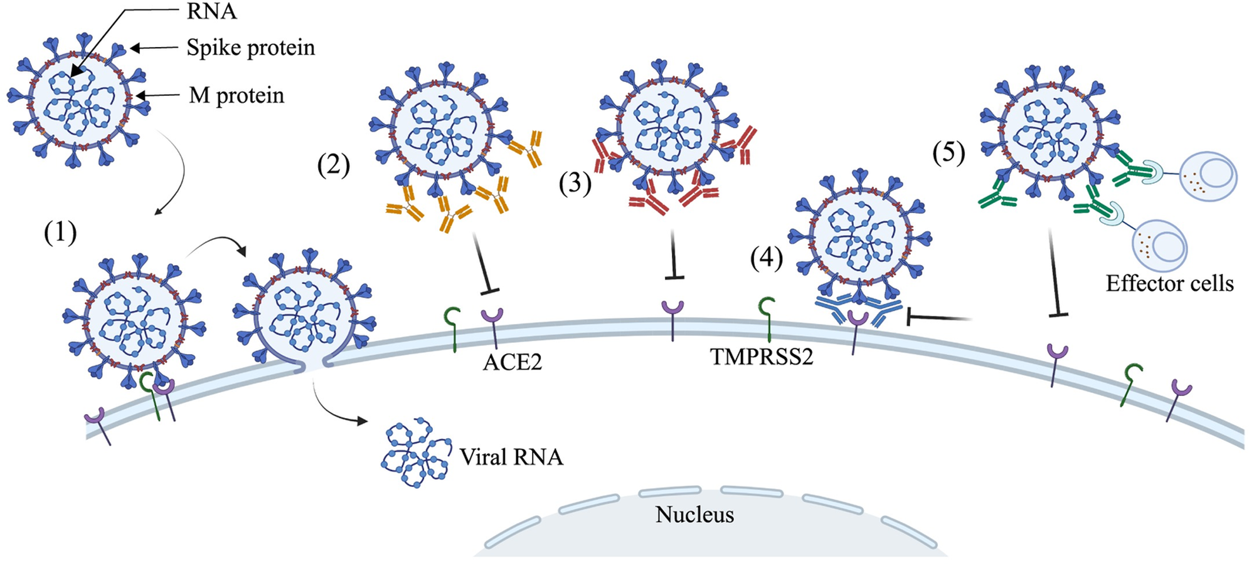
1.1.7.2. Spike Protein
Structural and antigenic variations in the spike protein of emerging SARS-CoV-2 variants,
PLoS Pathog 18(2): e1010260

Slide 27
1.1.7.3. Early Warning System (EWS)
Trains on the complete (up to a chosen time point) GISAID SARS-CoV-2 sequence database in less than a day and can score novel variants within minutes.
The EWS is fully scalable as new variant data become available, allowing for the continuous risk monitoring of variant lineages. We show that it can flag HRVs months earlier than their designation as such by the WHO, providing an opportunity to shorten the response time of health authorities.
Early Computational Detection of Potential High Risk SARS-CoV-2 Variants
1InstaDeep Ltd; 5 Merchant Square, London W2 1AY, UK.
2BioNTech SE; An der Goldgrube 12, 55131 Mainz, Germany.
3BioNTech US; 40 Erie Street, Cambridge, MA, 02139, USA.

Slide 28


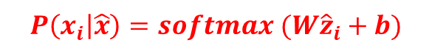

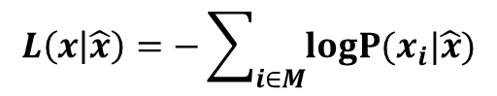
1.1.7.4. Implementation of EWS
Each amino acid is first tokenized, i.e. mapped to their
index in the vocabulary containing the natural amino
acids and then projected to an embedding space.
UniRef100 dataset, Fine tune the GISAID :
a positional encoding must be added to the embedding of
each token
a corrupted sequence $\hat{x}$
Embedding $\hat{z}$
The training objective corresponds to the negative
log-likelihood of the true sequence at the corrupted positions.
$$L\left(x | \hat{x}\right)=−\sum_{i∈M}{\operatorname{logP}{(x_{i}|\hat{x})}}$$
Parameters $θ$
$$P\left(x_{i} | \hat{x}\right)=softmax (W{\hat{z}}_{i}+b)$$
$$\max_{θ}{\log{P\left(x_{i} | \hat{x}, θ\right)}}$$
Embedding
Token: class, Mask, 20 amino acids

Slide 29
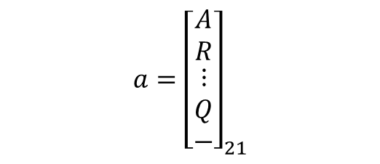
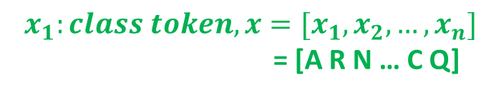

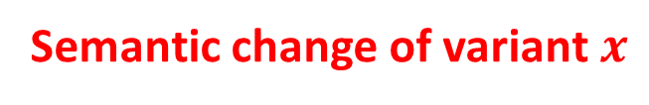
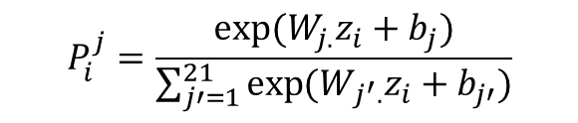
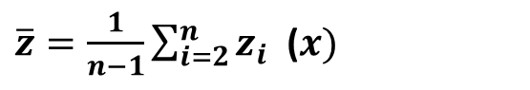
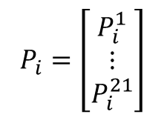
1.1.7.4. Implementation of EWS
Embedding: $z=\left[z_{1},…, z_{n}\right], z_{i}$ : sequence embedding vector at position $i$
$$a={\left[\begin{matrix}A \\ R \\ \begin{matrix}⋮ \\ Q \\ −\end{matrix}\end{matrix}\right]}_{21}$$
$\overline{z}=\frac{1}{n−1}\sum_{i=2}^{n}{z_{i}}$ ($x)$
Semantic change of variant $x$
$$∆z={\left\|\overline{z} −{\overline{z}}_{wuhuan}\right\|}_{1}+{\left\|\overline{z}−{\overline{z}}_{D614G}\right\|}_{1}$$
$$Y_{i}=Wz_{i}+b, i=1,…, n, P_{i}=softmax(Wz_{i}+b)$$
$$P_{i}=\left[\begin{matrix}P_{i}^{1} \\ ⋮ \\ P_{i}^{21}\end{matrix}\right]$$
$$P_{i}^{j}=\frac{exp⁡(W_{j.}z_{i}+b_{j})}{\sum_{j′=1}^{21}{\exp{(W_{j^{′}.}z_{i}}+b_{j′})}}$$
$$P\left(x_{i}=a_{j}\right)=P_{i}^{j}$$
$$x_{1}:class token, x=[x_{1}, x_{2}, …, x_{n}]$$
= [A R N … C Q]
The log-likelihood of a variant:
$$l\left(x\right)=\sum_{i=2}^{n}{\log{P\left(x_{i}=a_{j}\right)=\sum_{i=2}^{n}{\left[W_{j .}z_{i}+b_{j}−\log{\sum_{j=1}^{21}{\exp{(W_{j^{′}.}z_{i}}+b_{j′}}}\right]}}}$$

Slide 30
1.1.7.4. Implementation of EWS

Slide 31
1.1.7.5. Results of EWS
Full Transmissibility Potential of the Virus (Fitness)
ACE2 binding score: impact of sets of mutations on the binding affinity of the variant S protein to the human ACE2 receptor
Conditional log-likelihood score
Growth
Grammaticality

Slide 32
1.1.7.5.1. Results of EWS
log-likelihood ranked without correction for large mutation count
Omicron

Slide 33
1.1.7.5.2. Results of EWS
Omicron
log-likelihood ranked with correction
for large mutation count

Slide 34
1.1.7.5.3. Results of EWS
Combining fitness prior and immune escape scores

Slide 35
1.1.7.5.3. Results of EWS
Combining fitness prior and immune escape scores
Omicron

Slide 36
1.1.7.5.4. Results of EWS
Cumulative sum of all cases of a given variant lineage (in log scale) over time. Vertical lines indicate the date of WHO designation of a given variant (green dot-dashed) vs. date of flagging by the EWS (red dashed, using a weekly watch-list size of 20 variants).

Slide 37
1.1.7.5.4. Results of EWS

Slide 38
1.1.7.5.4. Results of EWS
Variants detected when using Epitope Alteration Score, Semantic Score and Immune Escape Score components of the EWS. The left bar chart displays the number of variants detected by EWS using different scores. The right partvisualises whether a WHO designated variant is detected in advance using different scores, where green dots indicate early detections and grey dots mean the variants are not detected in advance.

Slide 39
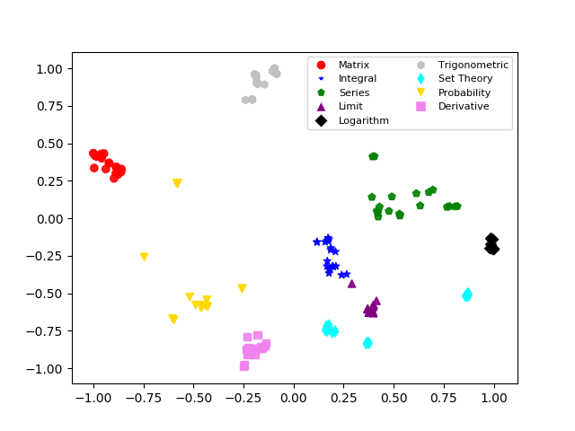
1.1.8. Embedding of Mathematic Formula
Mansouri, B. (2019). Tangent-CFT: An Embedding Model for Mathematical Formulas.
DOI:10.1145/3341981.3344235

Slide 40
Introduction 2
Genomic, Molecular, Protein and Biomedical Application

